Slide 1
Week 4: Swarm Optimization
Bose, Dao, and Sam

Slide 2
Problem
Goal: maximize portfolio return (no risk constraint)
Utilize swarm method
Limitations:
Dependence on Historical Covariance
Poor performance in dynamic markets

Slide 3
Firefly Implementation
Parameters:
Weights: list of (stock, weight)
sum of weights = 1
Stocks: top 10 (filtered by metric)
Budget: $10,000
Position: (x, y) ∈ [0,1]
Brightness: fitness score
Output:
Firefly instance
Valid portfolio allocation
Weight distribution across stocks
Key Idea:
Each firefly represents a candidate solution in the search space

Slide 4
Brightness & Cluster Brightness
Purpose: Evaluate fitness of each portfolio
Input:
Firefly (weights + stocks)
Method:
Compute portfolio returns over last 5 days
Calculate Sharpe Ratio
Output:
Fitness score (brightness)
Insight:
Higher Sharpe → brighter firefly
Balances return + consistency

Slide 5
Movement Function
Input:
Firefly 𝑖
Firefly 𝑗 (brighter)
Coordinate space
Rule:
Dim fireflies move toward brighter ones
Components:
Attraction → move toward better - solutions
Distance decay → closer fireflies influence more
Randomness → exploration
Output:
New position (x, y) ∈ [0,1]
Key Idea:
Enables guided search instead of random guessing

Slide 6
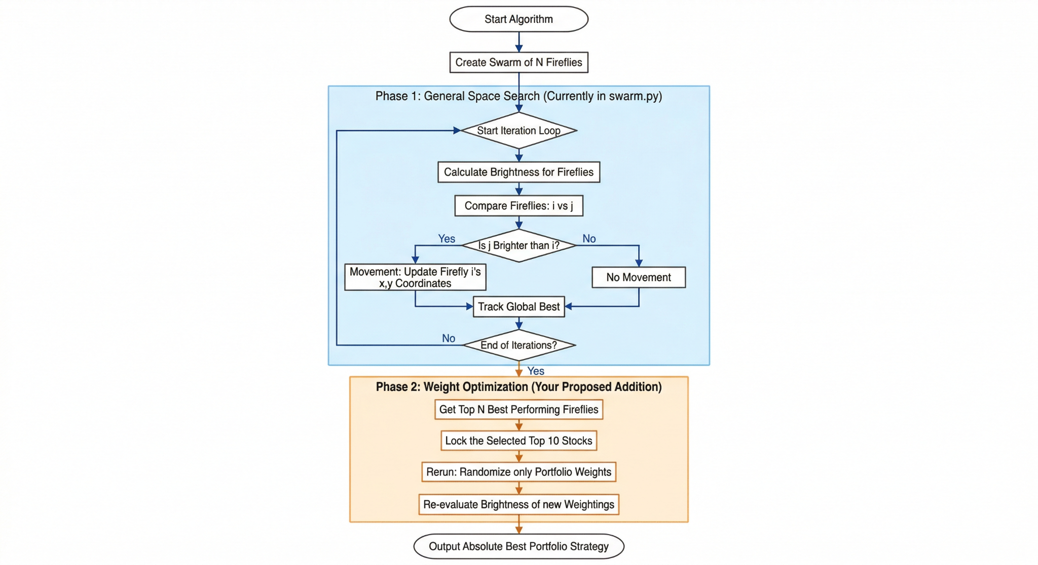
Algorithm

Slide 7
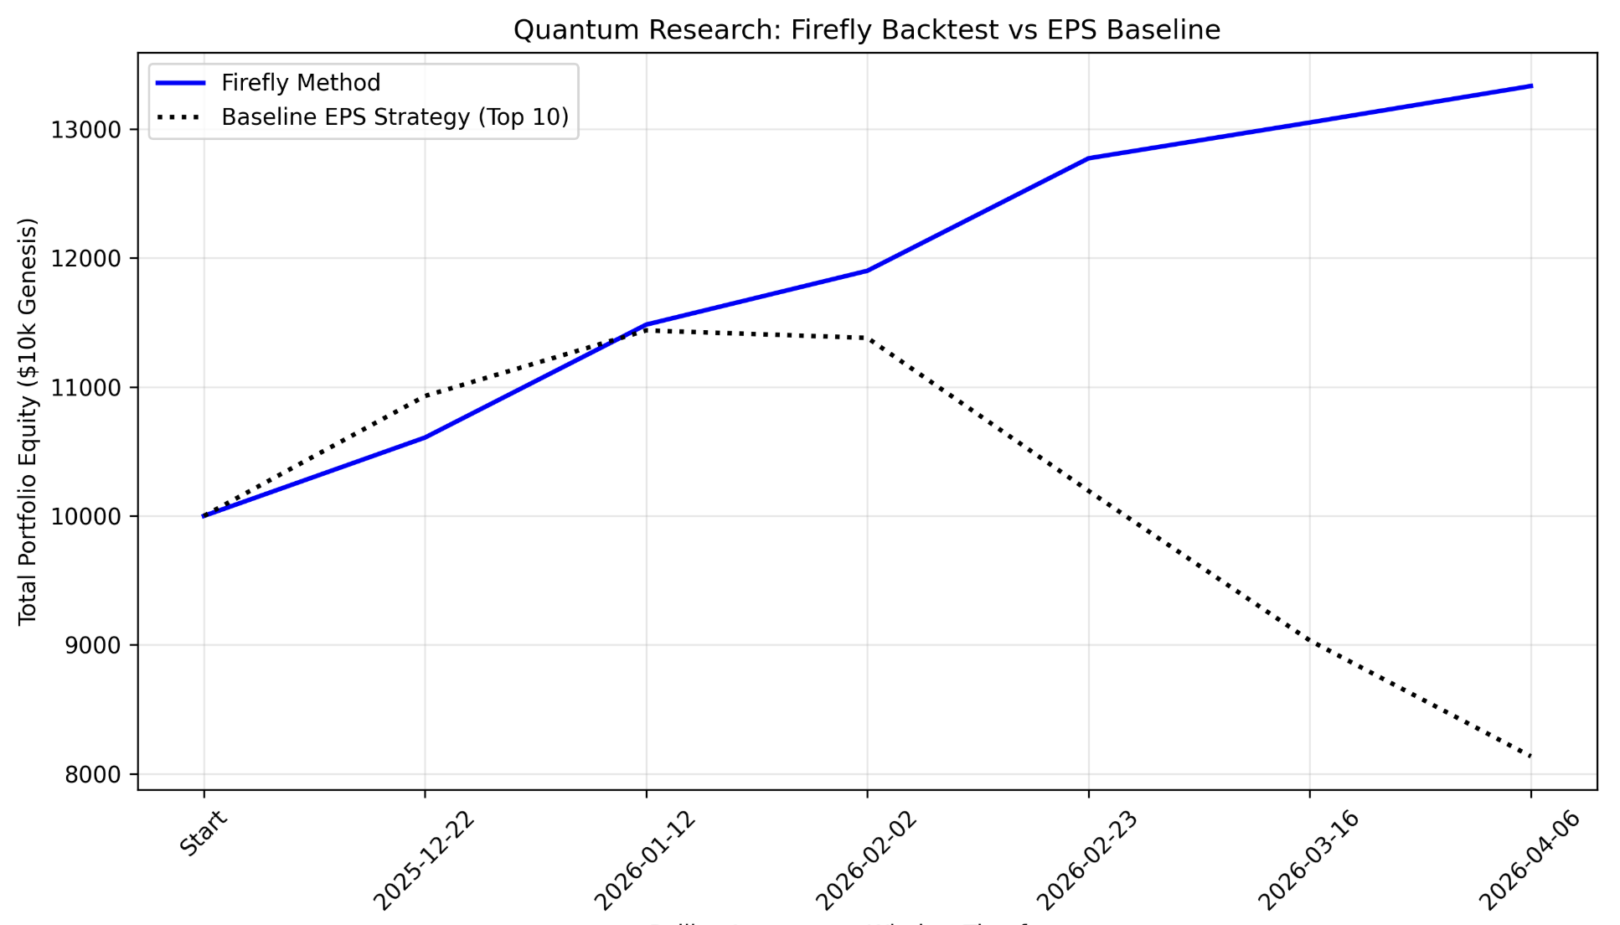
Results
Firefly Swarm Return (6 iterations): 31.623%
EPS Return: -18.64%

Slide 8
Quantum Implementation
Quantum Tunneling
Instead of the classic mechanics equations, we will measure the movement of the firefly using a quantum harmonic oscillator. This in turn will allow us to search the space exponentially faster while avoiding getting stuck
Quantum Annealing
We will replace our deterministic ranking method with QAOA. This will allow us to evaluate combinations of stocks simultaneously, outputting a Top 10 that considers complex covariance/risk interactions rather than just the raw metric score
Entanglement for the second interaction
This will allow us to reduce the size of the search space
Superposition
We can initialize our firefly in a superposition of multiple weight strategies simulatenously

